Slide 1

From Data to Impact:
Understanding Donor Giving Behavior at UWS
Caleb Cuterer, Shannon Hoffman, Krishna Pandari, Jim Pieper, Walgama jayasekara
SEPTEMBER 12, 2024

Slide 2


OBJECTIVE
Move non active donors active donors bucket cost effectively.

Slide 3
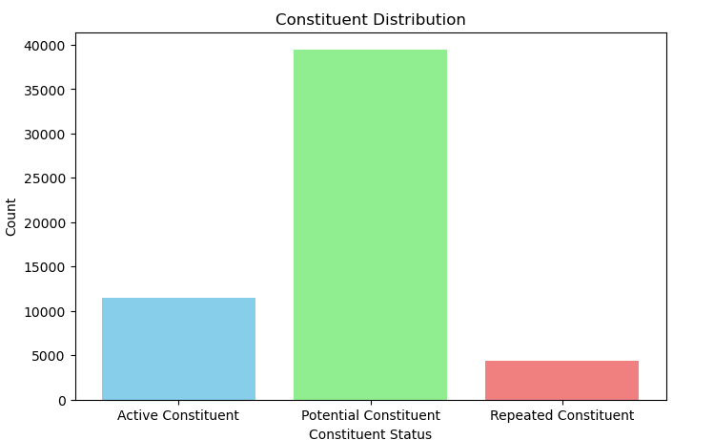
BACKGROUND
Approximately 80% of the dataset consists of non-active donors, representing a substantial portion of the total data. Therefore, it is crucial to implement a targeted campaign strategy to effectively address this segment. This approach will help minimize conversion costs by focusing efforts on turning non-active donors into active ones.

Slide 4
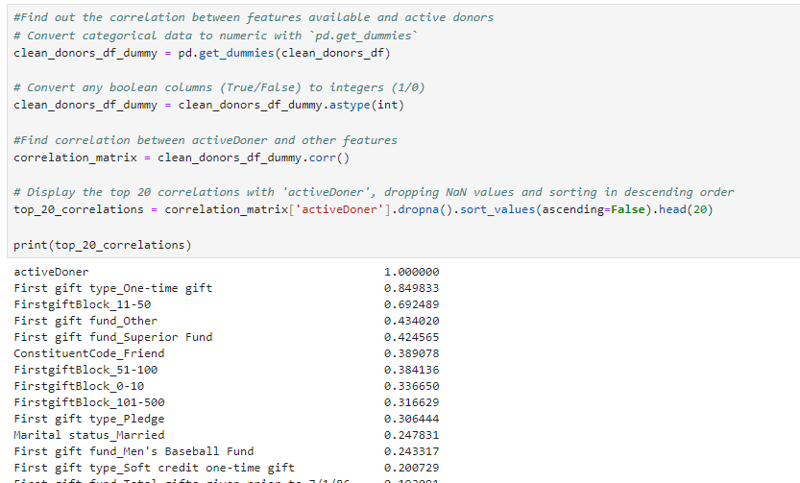
METHODOLOGY
Identify the most influential features of active donors and analyze the distribution of these features within the non-active donor segment.

Slide 5
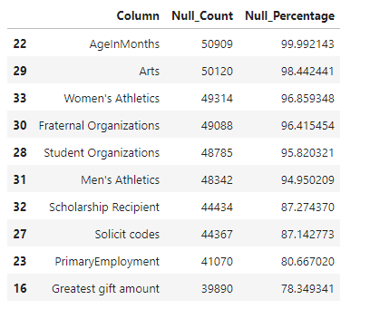
DATA PREPROCESSING
1.Eliminate feature columns with minimal data points.

Slide 6
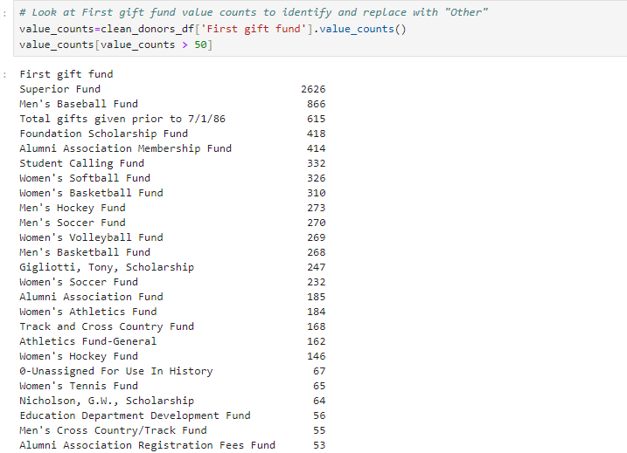
DATA PREPROCESSING
2.Reduce cardinality by consolidating infrequent data values.

